Slide 1
DASE 결과 보고

Slide 2
A. Preprocessing

Slide 3
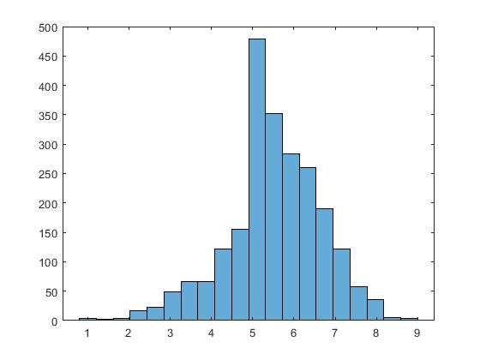
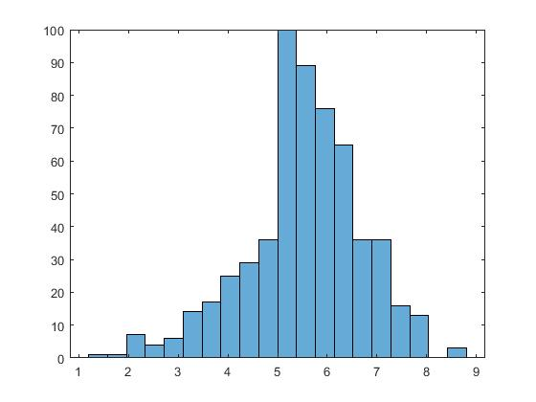
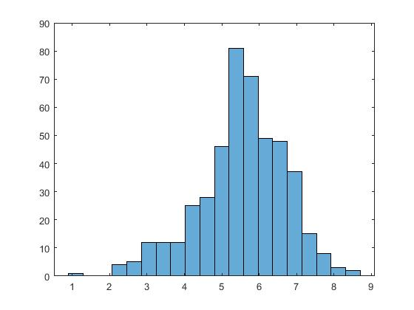
a. Remove Outlier (Confidence Interval 95%)
A. Preprocessing
CDOSE (Steroid 용량) > 20 = 20
CRP > 20 = 20
RF (Rheumatoid factor)> 1000 = 1000
ACCP (Anti-CCP)> 2000 = 2000
b. Stratified Data split (x-axis = DASE, y-axis = the number of data)
Train data
Test data
Valid data

Slide 4
B. Single model result

Slide 5
a. Single model Test Result
B. Single Model Result
MODEL | MAE | MSE | RMSE | MAPE | R2
XGBoost | 0.6119 | 0.6049 | 0.7777 | 0.1221 | 0.5556
AdaBoost | 0.6417 | 0.6549 | 0.8092 | 0.1303 | 0.5188
CatBoost | 0.6316 | 0.6379 | 0.7987 | 0.1298 | 0.5313
LightGBM | 0.6263 | 0.6338 | 0.7961 | 0.1260 | 0.5343
RandomForest | 0.6146 | 0.6199 | 0.7873 | 0.1243 | 0.5445
SVR | 0.6711 | 0.7173 | 0.8469 | 0.1381 | 0.4729
DNN | 0.7091 | 0.7782 | 0.8821 | 0.1385 | 0.4282

Slide 6
b. 5-fold cross validation result
B. Single Model Result
MODEL | MAE | MSE | RMSE | MAPE | R2
XGBoost | 0.6320±0.0198 | 0.6384±0.0389 | 0.7986±0.0244 | 0.1245±0.0039 | 0.5157±0.0218
AdaBoost | 0.6394±0.0132 | 0.6459±0.0326 | 0.8034±0.0203 | 0.1278±0.0018 | 0.5100±0.0159
CatBoost | 0.6358±0.0121 | 0.6433±0.0285 | 0.8018±0.0177 | 0.1284±0.0022 | 0.5119±0.0101
LightGBM | 0.6429±0.0183 | 0.6666±0.0397 | 0.8161±0.0244 | 0.1271±0.0028 | 0.4943±0.0215
RandomForest | 0.6408±0.0150 | 0.6540±0.0376 | 0.8083±0.0234 | 0.1277±0.0022 | 0.5039±0.0178
SVR | 0.7010±0.0150 | 0.7697±0.0428 | 0.8770±0.0245 | 0.1427±0.0030 | 0.4162±0.0171
DNN | 0.7291±0.0310 | 0.8538±0.0691 | 0.9234±0.0376 | 0.1417±0.0065 | 0.3529±0.0320

Slide 7
C. Oversampling method

Slide 8
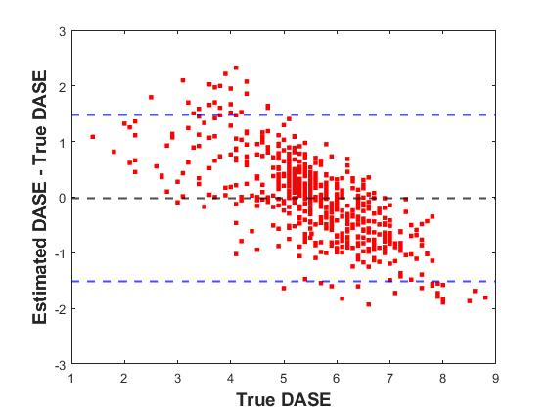
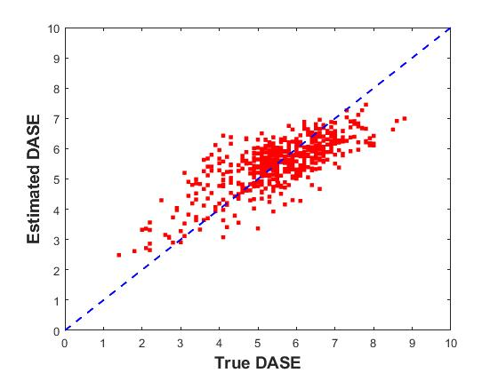
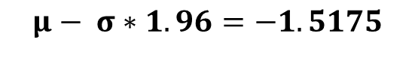
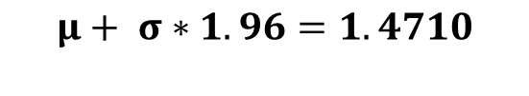
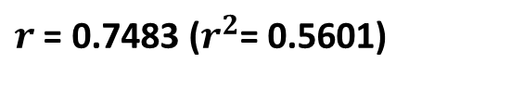
C. Not Oversampled
MODEL | SCORE | MAE | MSE | RMSE | MAPE | R2
XGB | Test | 0.6119 | 0.6049 | 0.7777 | 0.1221 | 0.5556
 | 5-fold Valid | 0.6320±0.0198 | 0.6384±0.0389 | 0.7986±0.0244 | 0.1245±0.0039 | 0.5157±0.0218
$$μ+ σ∗1.96=1.4710$$
$r$ = 0.7483 ($r^{2}$= 0.5601)
$$μ− σ∗1.96=−1.5175$$

Slide 9


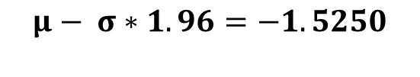
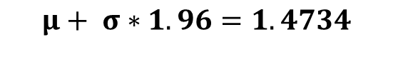
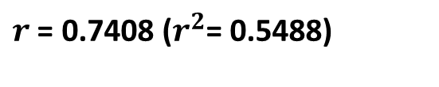
C. Random Oversampling^{[1]}
[1] Gaussian noise up-sampling is better suited than SMOTE and ADASYN for clinical decision making, BioData Mining 14 (2021): 1-11.
MODEL | SCORE | MAE | MSE | RMSE | MAPE | R2
XGB | Test | 0.5960 | 0.5841 | 0.7643 | 0.1179 | 0.5708
 | 5-fold Valid | 0.6400±0.0383 | 0.6564±0.0383 | 0.8098±0.0240 | 0.1261±0.0046 | 0.5022±0.0169
$$μ+ σ∗1.96=1.4734$$
$r$ = 0.7408 ($r^{2}$= 0.5488)
$$μ− σ∗1.96=−1.5250$$

Slide 10


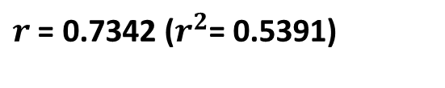
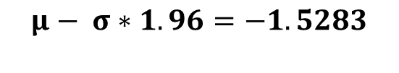
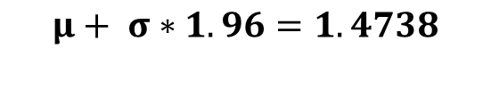
C. SMOGN Data
MODEL | SCORE | MAE | MSE | RMSE | MAPE | R2
XGB | Test | 0.6108 | 0.5940 | 0.7703 | 0.1218 | 0.5635
 | 5-fold Valid | 0.6417±0.0137 | 0.6584±0.0323 | 0.8112±0.0200 | 0.1270±0.0024 | 0.5005±0.0140
$$μ+ σ∗1.96=1.4738$$
$r$ = 0.7342 ($r^{2}$= 0.5391)
$$μ− σ∗1.96=−1.5283$$

Slide 11
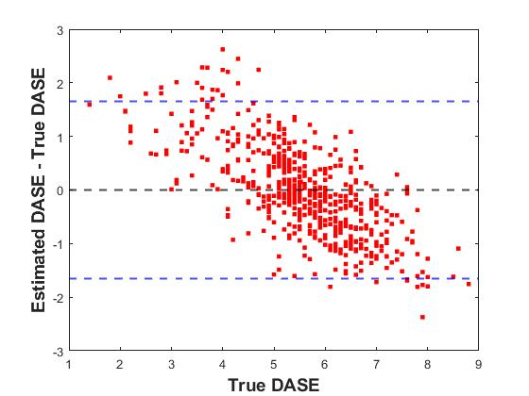
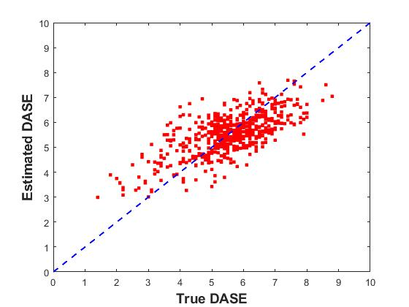
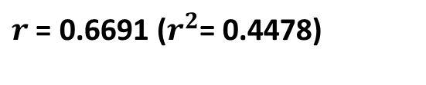
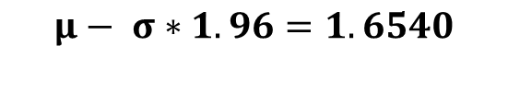
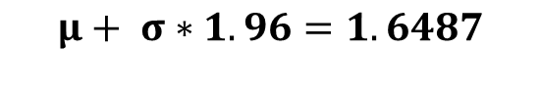
C. DNN + Weighted loss function
DASE < 4, DASE > 7 data에 Weight 2배 적용
MODEL | SCORE | MAE | MSE | RMSE | MAPE | R2
DNN | Test | 0.6649 | 0.7090 | 0.8420 | 0.1354 | 0.4790
 | 5-fold Valid | 0.6922±0.0133 | 0.7644±0.0372 | 0.8741±0.0212 | 0.1396±0.0038 | 0.4202±0.0122
$$μ+ σ∗1.96=1.6487$$
$r$ = 0.6691 ($r^{2}$= 0.4478)
$$μ− σ∗1.96=1.6540$$

Slide 12
D. Random Oversampling Result

Slide 13
a. 5-fold cross validation result
D. Random Oversampling Result
MODEL | MAE | MSE | RMSE | MAPE | R2
XGBoost | 0.6400±0.0383 | 0.6564±0.0383 | 0.8098±0.0240 | 0.1261±0.0046 | 0.5022±0.0169
AdaBoost | 0.6481±0.0171 | 0.6622±0.0451 | 0.8132±0.0276 | 0.1296±0.0025 | 0.4977±0.0255
CatBoost | 0.6430±0.0129 | 0.6596±0.0277 | 0.8120±0.0170 | 0.1292±0.0030 | 0.4991±0.0225
LightGBM | 0.6502±0.0154 | 0.6824±0.0304 | 0.8259±0.0183 | 0.1285±0.0021 | 0.4821±0.0162
RandomForest | 0.6418±0.0152 | 0.6634±0.0404 | 0.8141±0.0247 | 0.1280±0.0021 | 0.4968±0.0207
SVR | 0.7003±0.0171 | 0.7697±0.0481 | 0.8769±0.0277 | 0.1417±0.0038 | 0.4163±0.0225
DNN | 0.7256±0.0131 | 0.8465±0.0458 | 0.9198±0.0249 | 0.1477±0.0034 | 0.3577±0.0251

Slide 14
E. Ensemble Result

Slide 15
a. 5-fold cross validation result (soft voting)
E. Model Ensemble Result
MODEL | MAE | MSE | RMSE | MAPE | R2
XGB & CB | 0.6313±0.0117 | 0.6368±0.0303 | 0.7977±0.0189 | 0.1255±0.0022 | 0.5168±0.0146
XGB & RF | 0.6363±0.0170 | 0.6491±0.0386 | 0.8053±0.0240 | 0.1261±0.0036 | 0.5077±0.0176
XGB & ADA | 0.6379±0.0152 | 0.6434±0.0390 | 0.8179±0.0243 | 0.1266±0.0030 | 0.5120±0.0181
XGB & LGB | 0.6354±0.0171 | 0.6480±0.0345 | 0.8047±0.0215 | 0.1254±0.0034 | 0.5084±0.0152
XGB & SVR | 0.6415±0.0167 | 0.6524±0.0421 | 0.8072±0.0263 | 0.1281±0.0037 | 0.5053±0.0201
b. 5-fold cross validation result (stacked ensemble)
MODEL | MAE | MSE | RMSE | MAPE | R2
XGB & CB & RF & ADA & LGB & SVR | 0.7613±0.1560 | 1.000±0.4272 | 0.9778±0.2093 | 0.1621±0.0436 | 0.2367±0.3353

Slide 16
F. Data Re-labeling
Data[DASE < 4] = 4
Data[DASE > 7] = 7

Slide 17
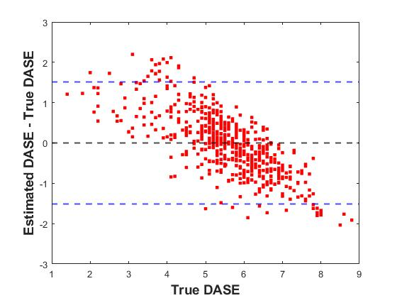
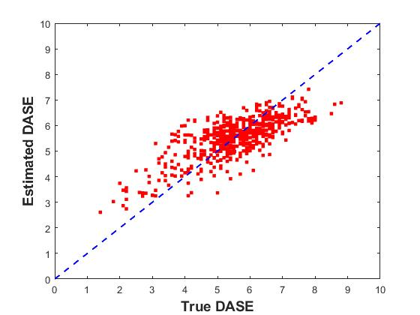
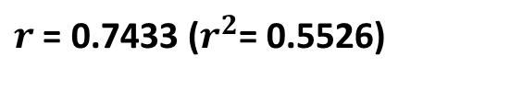
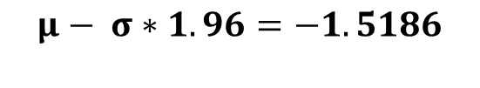
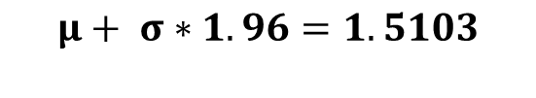
a. 5-fold cross validation result (Not Re-labeled)
F. Data RE-labeling
MODEL | SCORE | MAE | MSE | RMSE | MAPE | R2
XGB & CB | 5-fold Valid | 0.6313±0.0117 | 0.6368±0.0303 | 0.7977±0.0189 | 0.1255±0.0022 | 0.5168±0.0146
 | Test | 0.6153 | 0.6089 | 0.7803 | 0.1240 | 0.5526
$$μ+ σ∗1.96=1.5103$$
$r$ = 0.7433 ($r^{2}$= 0.5526)
$$μ− σ∗1.96=−1.5186$$

Slide 18
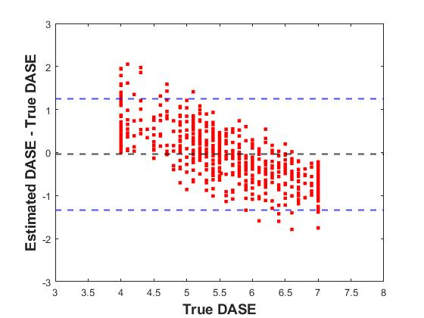
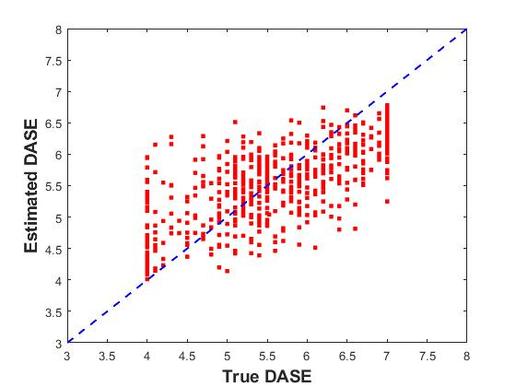
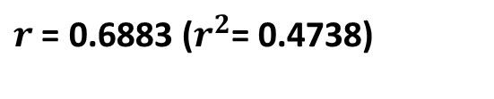
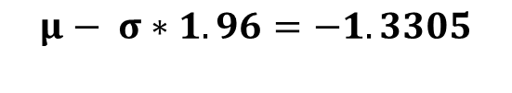
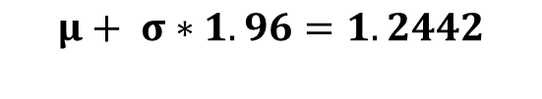
a. 5-fold cross validation result (Re-labeled, Data[DASE < 4] = 4 Data[DASE > 7] = 7)
F. Data RE-labeling
MODEL | SCORE | MAE | MSE | RMSE | MAPE | R2
XGB & CB | 5-fold Valid | 0.5465±0.0152 | 0.4617±0.0313 | 0.6791±0.0229 | 0.1001±0.0030 | 0.4496±0.0243
 | Test | 0.5321 | 0.4426 | 0.6652 | 0.0989 | 0.4738
$$μ+ σ∗1.96=1.2442$$
$r$ = 0.6883 ($r^{2}$= 0.4738)
$$μ− σ∗1.96=−1.3305$$

Slide 19
F. Data 3 stage classification
Data[DASE < 4] = 0
Data[4 < DASE < 7] = 1
Data[DASE > 7] = 2

Slide 20
a. Single model Test result
E. Data classification
MODEL | Accuracy | Sensitivity | Specificity | F1-score | Balanced accuracy
XGB | 0.8606 | 0.5158±0.4198 | 0.7583±0.4004 | 0.5698±0.3383 | 0.6370±0.0644
DNN | 0.8414 | 0.4746±0.4321 | 0.7348±0.4331 | 0.5215±0.3524 | 0.6047±0.0395
Predict
True | 16 | 37 | 0
 | 5 | 460 | 11
 | 0 | 38 | 7
Predict
True | 22 | 31 | 0
 | 6 | 465 | 5
 | 0 | 38 | 7
XGB
DNN

Slide 21
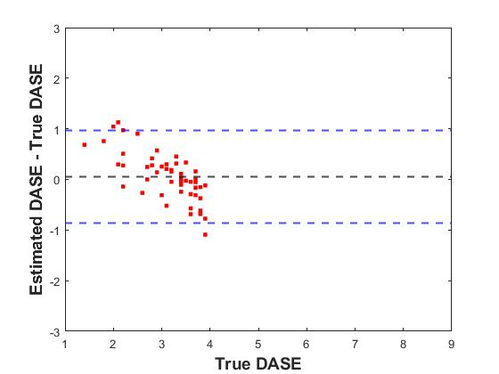
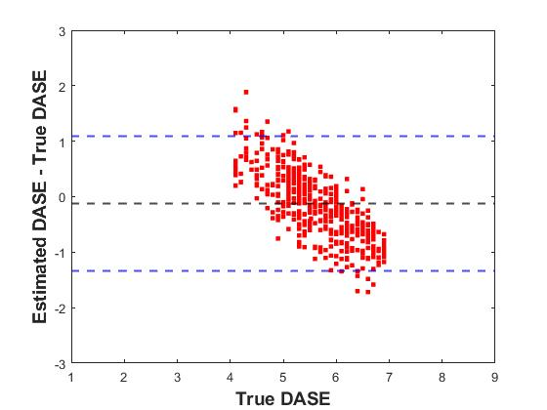
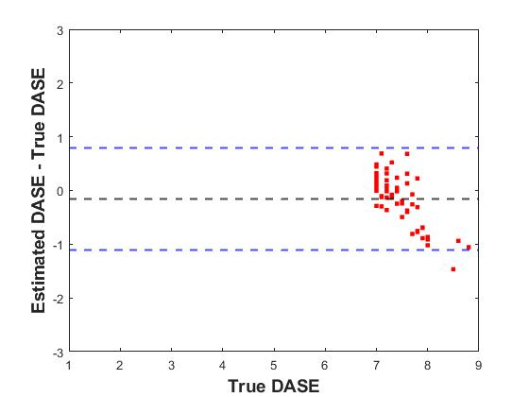
a. Plot
E. Data classification

